Slide 1
Capstone Engagement
Assessment, Analysis, and Hardening of a Vulnerable System
Creator: Stephanie Lin

Slide 2
Table of Contents
This document contains the following sections:
01
Network Topology
02
Red Team: Security Assessment
03
Blue Team: Log Analysis and Attack Characterization
Hardening: Proposed Alarms and Mitigation Strategies
04

Slide 3
Network Topology
‹#›

Slide 4
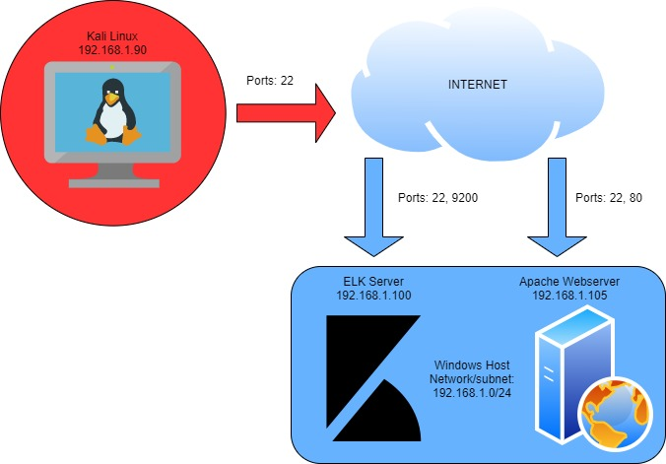
Network Topology
Network
Address Range:192.168.1.1-255
Netmask:192.168.1.0/24
Gateway: 192.168.1.1
Machines
IPv4: 192.168.1.1
OS: Windows
Hostname:
IPv4: 192.168.1.90
OS: Kali Linux
Hostname: Kali
IPv4: 192.168.1.100
OS: Linux
Hostname: ELK
IPv4: 192.168.1.105
OS: Linux
Hostname: Capstone

Slide 5

Red Team
Security Assessment
‹#›

Slide 6
Recon: Describing the Target
Nmap identified the following hosts on the network:
Hostname | IP Address | Role on Network
ML-RefVm-684427 | 192.168.1.1 | Gateway/Host Virtual Machine
Kali | 192.168.1.90 | Attacking Machine
ELK | 192.168.1.100 | Data Collection Machine/SIEM
Capstone | 192.168.1.105 | Target Machine

Slide 7
Vulnerability Assessment
The assessment uncovered the following critical vulnerabilities in the target:
Vulnerability | Description | Impact
Administrative Control Vulnerability. | An administrative control vulnerability is an improper separation of duties, improper data classification, or improper auditing. | If users have access to restricted information, they could leak it, alter it, or use it to gain greater access. If private data is made public, it may be exploited. If audits are improper or non-existent, vulnerabilities will be missed.
Brute Force Vulnerability | A brute force vulnerability is poor username and password policies or storage. | If usernames are known or easy to find, attacker can plug that into a wordlist to determine the userpassword. If passwords are weak or improperly stored, they are easily guessed, accessed or cracked, leading to unauthorized access.
PHP Reverse Shell Vulnerability | PHP reverse shell vulnerability is the ability to upload a malicious php file and execute it through a web browser, so that a remote attacker can control the server. | If malicious actors gain control of a server, there are many nefarious things they could do. They could shut it down, turn it into a zombie, steal or copy sensitive files, upload malicious content, or simply monitor the network.

Slide 8
Exploitation: Administrative Control Misconfiguration
01
02
03
Tools & Processes
We used Nmap to scan for active IP’s and ports on the network and their functions, navigated to the web server IP, and gained open access to files and folders. Hidden files that did require user authentication all but explicitly stated which user had access. From this information, we were able to brute force the password and gain further access.
Achievements
Since access to some company folders was not password protected, we were able to snoop around the files and discover the a hidden folder. While this folder was password protected, the login screen directed our efforts for a brute force attack, thereby significantly shortening the time it took to gain access.
See screenshots below for steps.

Slide 9
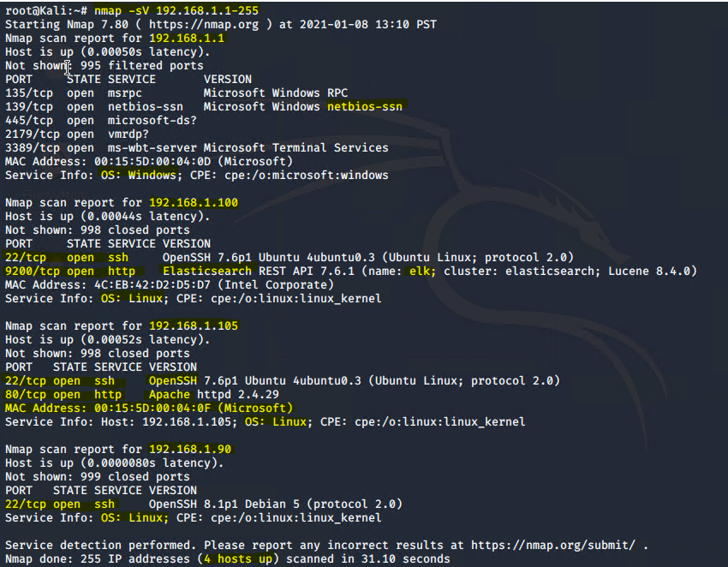
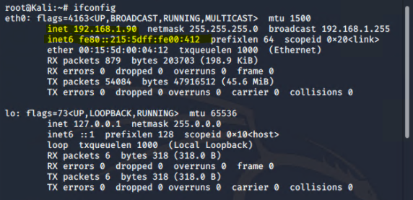
Nmap scan
Port 9200 indicates that the ELK server is running on 192.168.1.100. Apache running indicates that the host machine is a web server. Therefore, 192.168.1.105 is the IP we’re after on either port 22 or port 80.

Slide 10
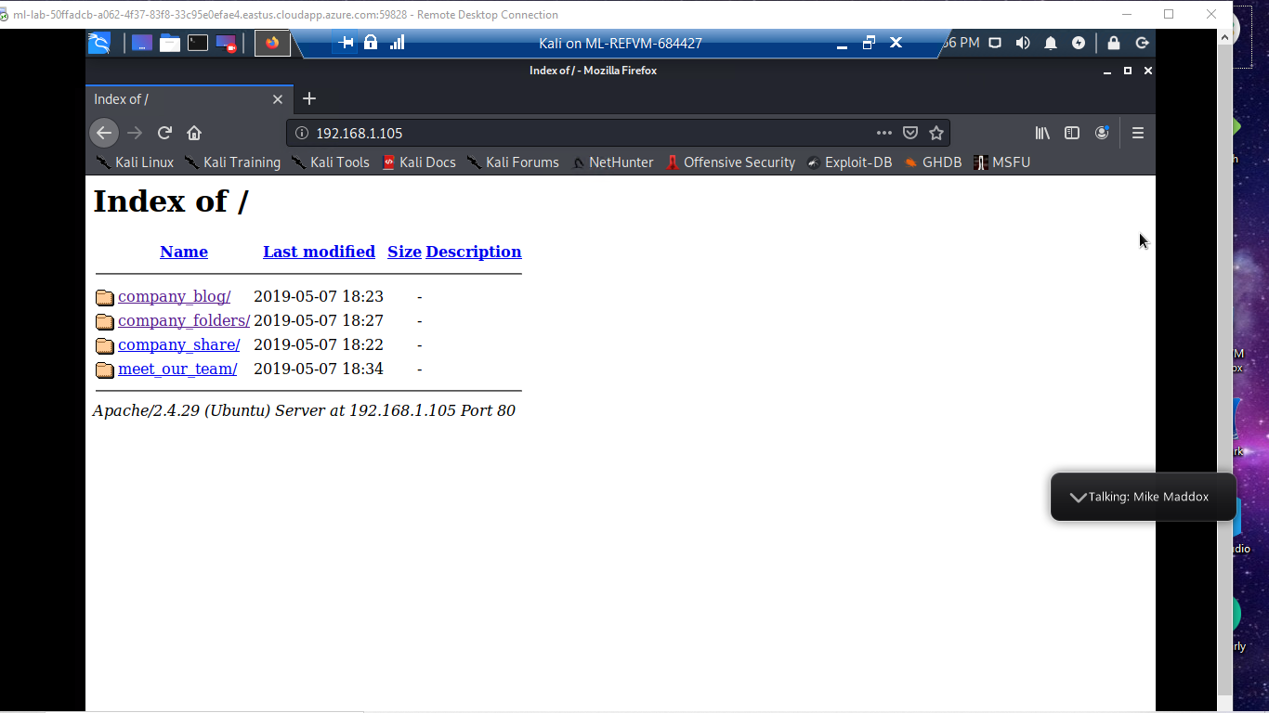
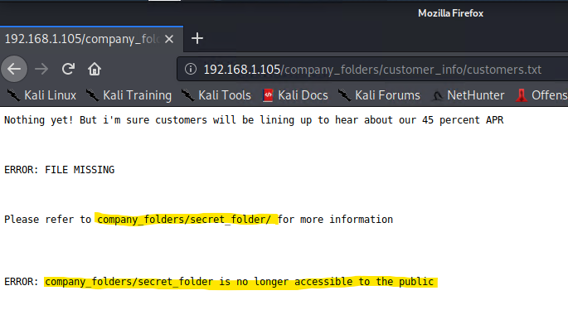
Navigate to the Apache Server IP
No password is blocking access to this IP. Company folders are publicly displayed and accessible. One of the files mentions a private “secret folder.”

Slide 11
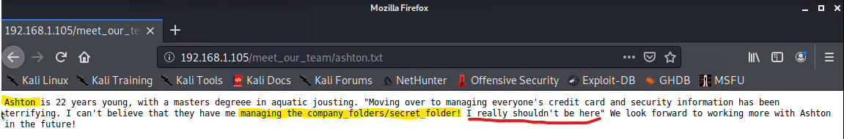
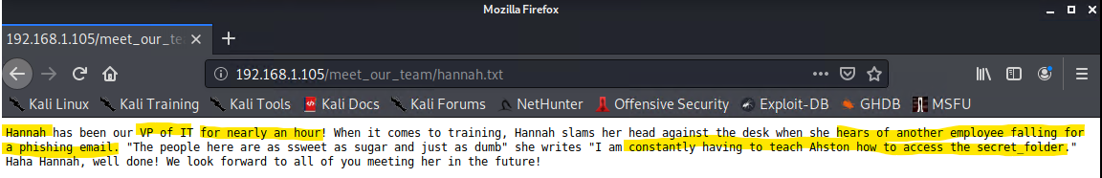
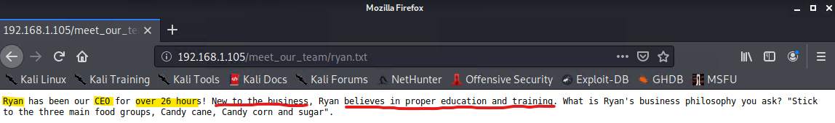
Displays of Incompetence, Pt. 1
Notes:
The company appears to be a very recent start up since it only appears to consist of three individuals, all with minimal to no experience. The tone suggests that Ashton wrote all the blurbs. Ashton clearly has no experience in data privacy since he openly names the location of secret company information on multiple pages of the public website, even calling to attention that he frequently forgets how to access this information. One can also infer that Ashton and Ryan both fall prey to phishing email scams since Hannah blurb suggests that multiple employees of this three person company fall for phishing and she is the odd one out. If Ryan has less than a week’s worth of experience but truly does “believe in proper education and training,” both he and Ashton are in need of some serious cybersecurity training. Maybe with a bit of training Ashton won’t be so nervous that he’s publicly declaring his lack of confidence.

Slide 12
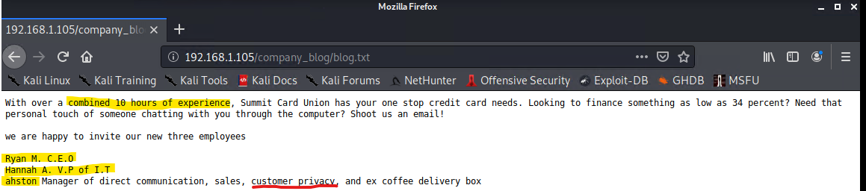
Displays of Incompetence, Pt. 2
Since this is part of the company’s public facing web page, it should present the company in a good light. Touting less than a day’s collective hours of experience does not inspire confidence in any of these people’s capabilities. This lack of established trust is especially detrimental since they appear to offer financial services. The fact that the Manager of Direct Communication as well as Customer Privacy can’t spell or punctuate his name correctly and stores private information for the company in public is also cause for concern.

Slide 13
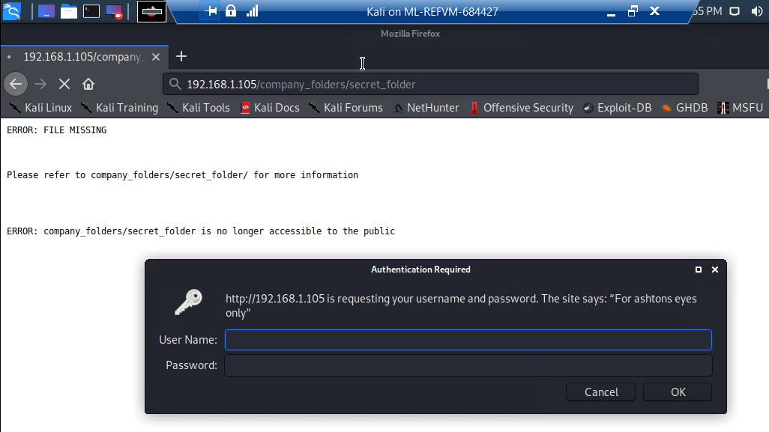
Not-so Secret File Access
While this folder is password protected, the note “For ashtons eyes only” indicates that at least one user with access is most likely Ashton. Due to the lack of capitalization and punctuation, the probable syntax of the username is “ashton”. Now we can attempt to brute force his password.

Slide 14
Exploitation: Brute Force
01
02
03
Tools & Processes
With the username obtained due to improper administrative controls, we used Hydra to crack Ashton’s password to gain access to the secret folder which contained a password hash for Ryan and instructions for logging into the company’s webdav server. We used crackstation.net to break the hash and gain access to the server on Ryan’s account.
Achievements
We cracked Ashton’s password and gained access to the secret folder. Then we cracked the hash for Ryan’s password and gained access to the server on what is likely an administrative account.
See screenshots below for steps.

Slide 15
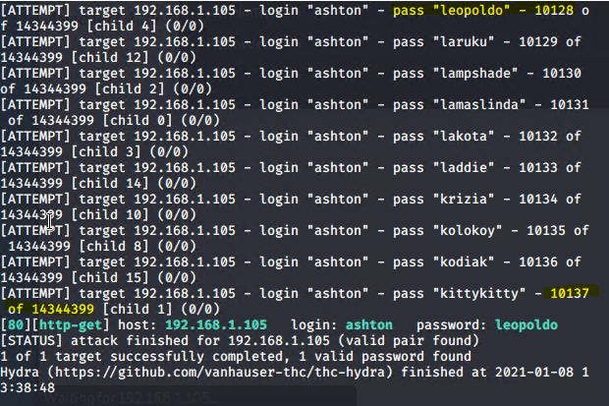
Hydra
Since we know what port to scan and the host IP from our Nmap activity as well as the likely username from poor administrative controls, we plugged this information into Hydra and successfully cracked the (weak) password.

Slide 16
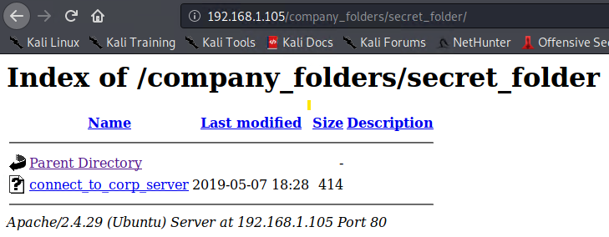
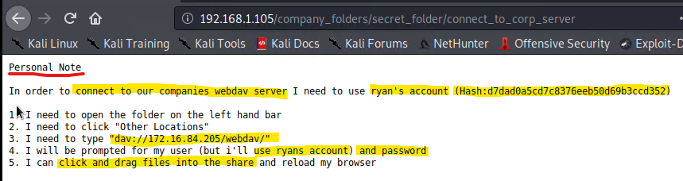
Access gained, more users exposed
Returning to the login for the secret folder, we gain access using the brute-forced password and discover another username and password hash along with instructions for logging into the server and uploading files to it.

Slide 17
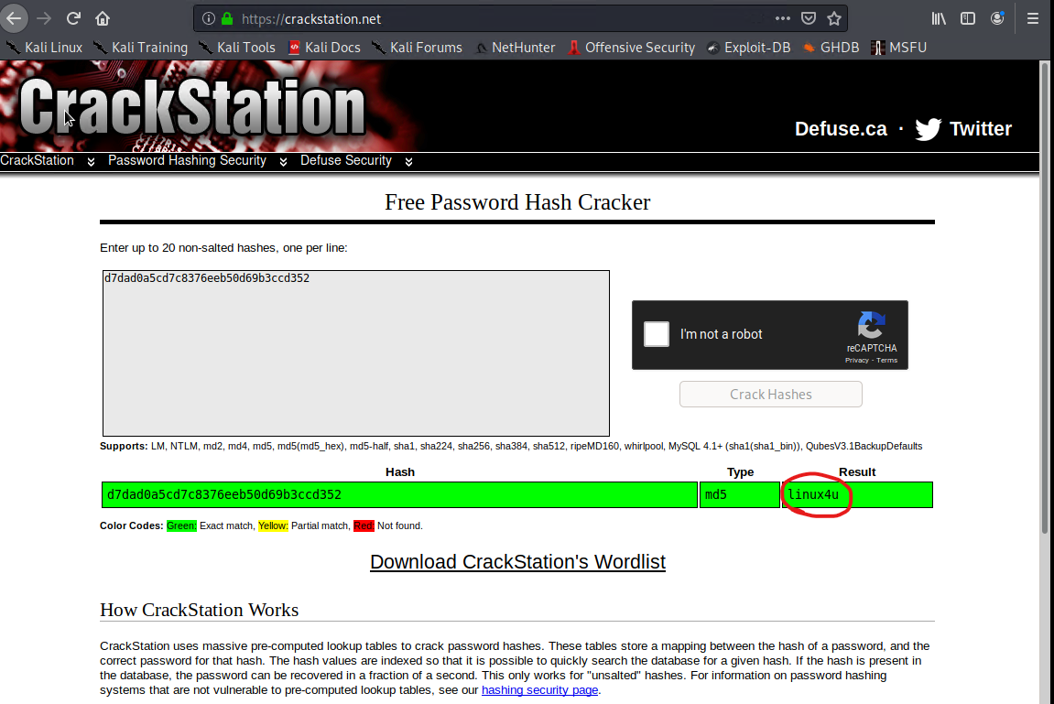
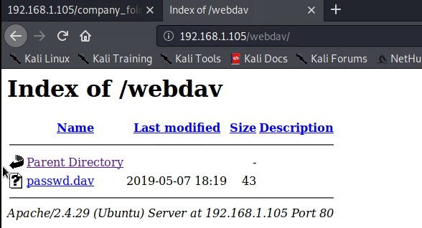
Password cracked, more access gained
We used crackstation.net to break the hash for ryan’s password, then used that password to log into the server. Although the IP given in the instructions is defunct, the previously used IP of 192.168.1.105 works. Now we can upload malicious files and view whatever files Ryan has access to on the server.

Slide 18
Exploitation: PHP Reverse Shell
01
02
03
Tools & Processes
We used MSFvenom to create a php reverse shell payload. We used our brute forced credentials to create a shared network folder where we uploaded the payload to the target server. We used msfconsole to start the listener. Once the listener was running on the attacking side, we activated the shell by clicking the file from the target side. This opened a meterpreter session that gave us access to the server files.
Achievements
We uploaded a reverse shell listener to the webdav server using our brute forced credentials. Once the shell was on the target machine, we activated the listener from the target side, creating a user shell in a meterpreter session. Through this shell, we gained access to the webdav server files.
See screenshots below for steps.

Slide 19
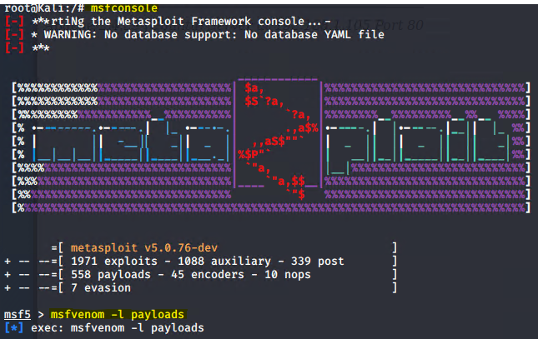
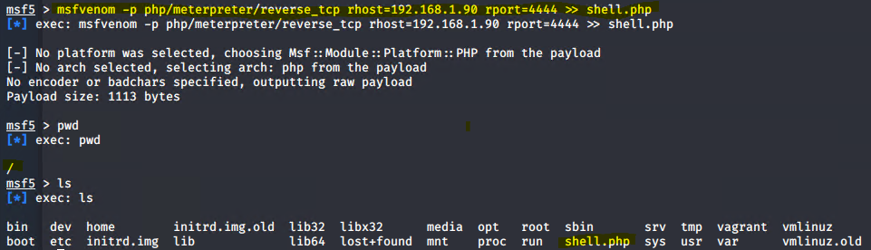
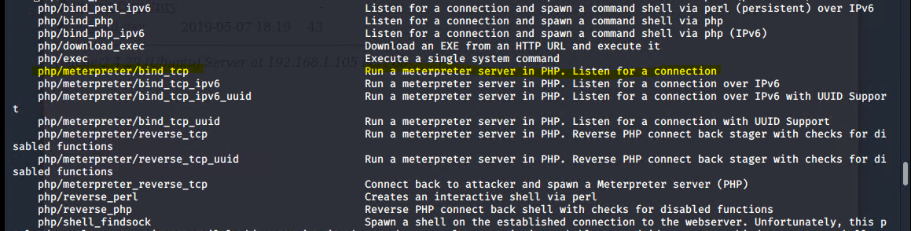
MSFvenom/MSFconsole
We used msfvenom to select a payload and crafted it in msfconsole. We chose the payload php/meterpreter/reverse_tcp

Slide 20
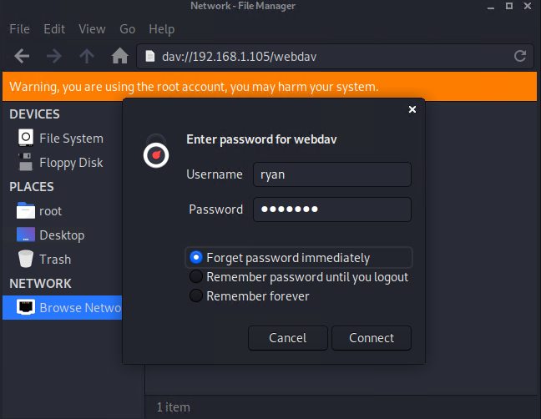
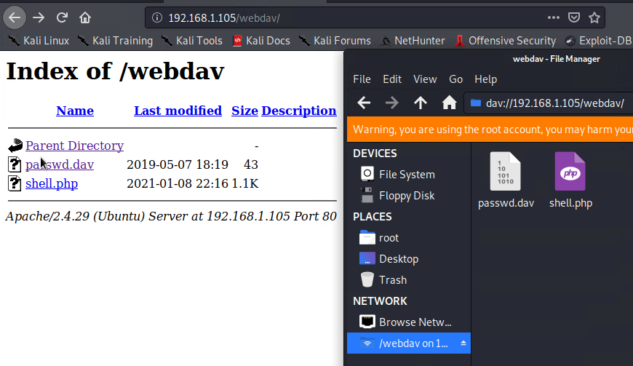
Uploading the Payload
Since we already have Ryan’s credentials for the webdav server, we are able to create a shared network folder from the attacking machine and copy the payload file to the target network.

Slide 21
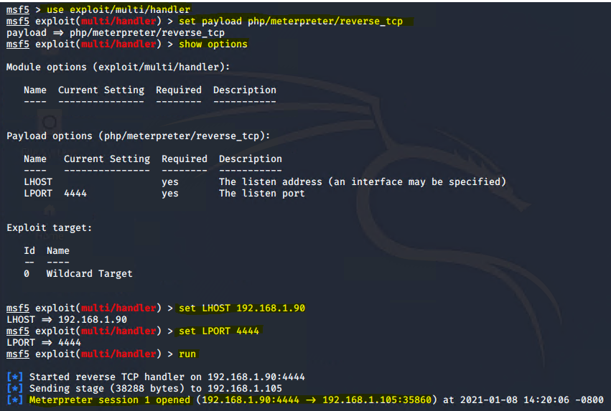
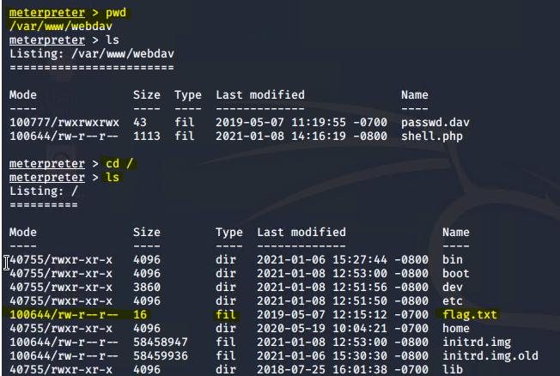
Start the Listener, Access Server Files
Now that the shell file is on the target machine, we started the listener in msfconsole using the multi/handler exploit. Once the shell opened a user meterpreter session, we clicked on the shell file in the target machine’s webdav server to activate the payload. From there, in the user shell, we were able to locate the flag file we were tasked with finding.

Slide 22

Blue Team
Log Analysis and Attack Characterization
‹#›

Slide 23

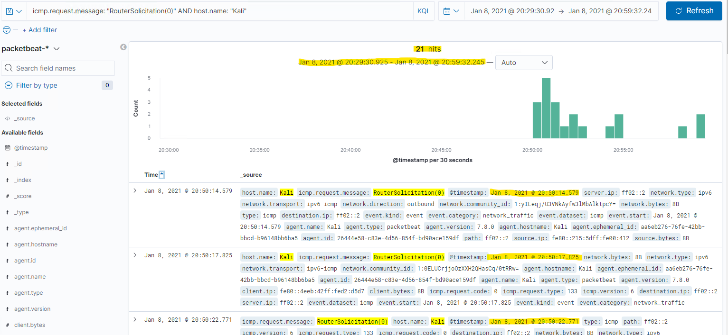
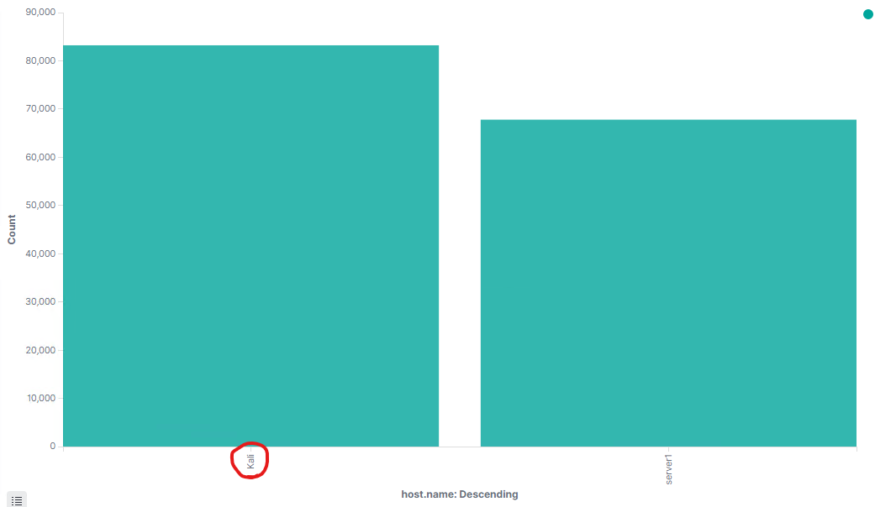
Analysis: Identifying the Port Scan
The port scan occurred from 01/08/21 @20:50:14.579 to 01/08/21 @20:59:32.245.
21 packets were sent from the ipv6 that matches the attacking Kali Linux machine (ipv4: 192.168.1.90 | ipv6: fe80:215:5dff:fe00:412)
Since many packets were sent in quick succession to each sequential destination IP within a range, we can determine that this is a port scan.

Slide 24
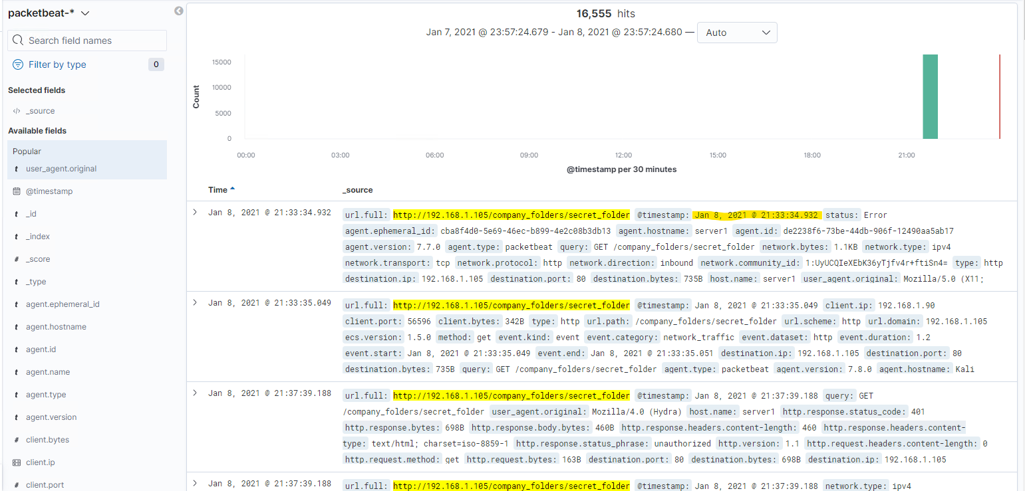
Analysis: Finding the Request for the Hidden Directory
On 01/08/21 @21:33:34, the folder /company_folders/secret_folder was requested.
The only file within secret_folder was connect_to_corp_server. While Kibana does not tell us what was in the file, we know it contains instructions to log into the company’s webdav server using Ryan’s account and his password hash.

Slide 25
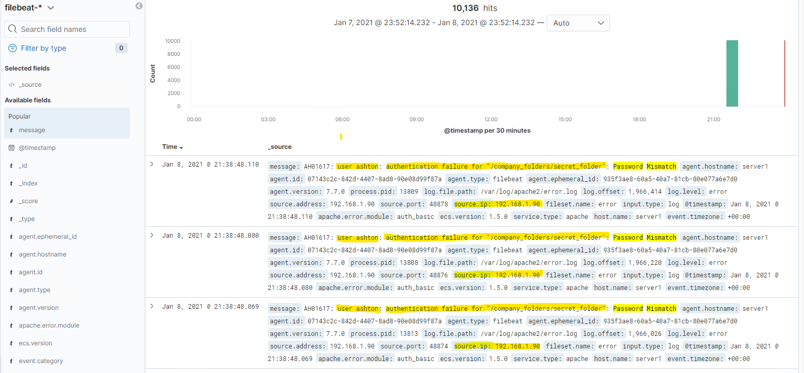
Analysis: Uncovering the Brute Force Attack
16,555 requests were made during the attack. (See previous slide for graphic)
The attacker made 10,136 requests before finding the password. (See slide 15 for attacking confirmation.)
Notes:
When we brute forced Ashton’s password, the correct solution was the 10,128th attempt, but Hydra continued to make a total of 10,137 attempts. (Possible program lag.) The number shown above is, of course, one less than the Hydra total attempts because only failed attempts are shown. Obviously, one succeeded. Another way to find evidence of the brute force attack is in the results for user_agent.original. For the brute forced connections, the user_agent.original is a version of Mozilla Firefox with Hydra. Since Hydra is a brute force password program, and sign of Hydra is a brute force attempt.

Slide 26
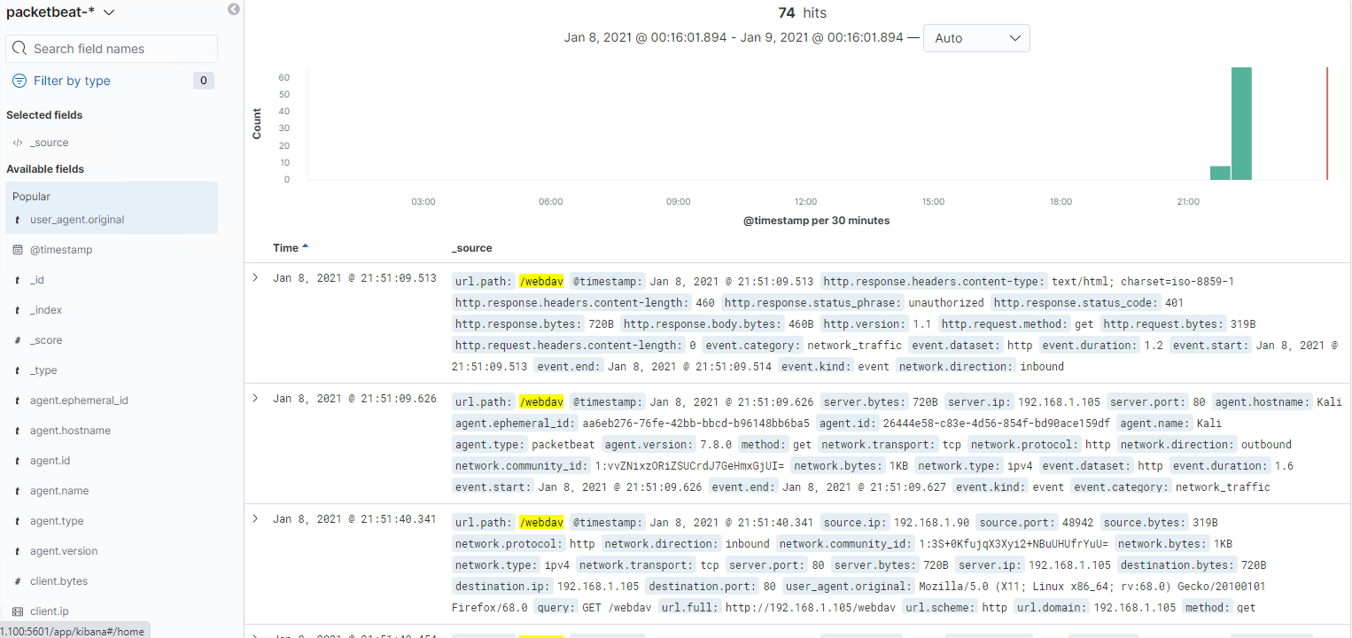
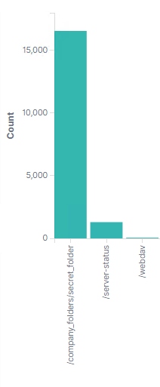
Analysis: Finding the WebDAV Connection
74 requests were made to this directory and its files.
The passwd.dav and shell.php files were requested.
Notes:
The right-side bar chart shows the count of url paths accessed. /company_folders/secret_folder has the highest count since it experienced the brute force attack, while /webdav has significantly fewer since only a hash had to be cracked rather than thousands of passwords attempted. This is not to be underestimated. Although the /webdav connection shows less of a spike in traffic, it is the insecurity that allowed the greatest amount of damage.

Slide 27
Blue Team
Proposed Alarms and Mitigation Strategies
‹#›

Slide 28
Mitigation: Blocking the Port Scan
What kind of alarm can be set to detect future port scans?
Set an alarm for an excessive number of icmp packets.
Threshold
We recommend a threshold of 5, given that the total number of events in this attack appears to be lower but is still nevertheless a threat.
What configurations can be set on the host to mitigate port scans?
Firewall settings can be configured to filter the ports so an Nmap scan can’t tell whether the ports are open or closed.
Here is one example of a script that can be run for continuous protection (renews on reboot) against port scans: https://github.com/Feriman22/portscan-protection
Notes:
*Note: This is based off data from my reset VM’s attack on the Capstone machine. In the original attack, the data showed successive ipv4 addresses being probed. For some reason, this data shows different ipv6 addresses being attacked. The original data was clearer, but unfortunately, it was lost and I am unsure what difference exists that makes the data difficult to replicate.

Slide 29
Mitigation: Finding the Request for the Hidden Directory
What kind of alarm can be set to detect future unauthorized access?
Set an alarm for when requests for the /secret_folder exceed what is normal for the company.
Threshold
Since this is a very small company, we recommend a threshold of 10 events,.
What configuration can be set on the host to block unwanted access?
The main reason this folder is being accessed by someone outside the company is because the existence of the folder was made public due to sheer negligence. All statements referencing /secrect_folder and how to access it should be scrubbed from the public-facing website. In the wake of this attack, the folder should be renamed to something less conspicuous and a stronger password policy should be implemented. Ashton’s password only contained 8 lowercase letters. Similarly, Ryan’s password only contained 7 lowercase letters and one number. These should be changed immediately and a standard of 15-20 alphanumeric upper- and lowercase letters plus symbols changed monthly and not the same as the last 3 passwords should be implemented.

Slide 30
Mitigation: Preventing Brute Force Attacks
What kind of alarm can be set to detect future brute force attacks?
An alarm could be set for any message that contains the phrase “Password Mismatch” or “authentication failure.” Alternatively, an alarm could be set for multiple log.level: error from the same IP.
Threshold
We recommend a threshold of 8 failed password attempts for any given user/IP.
What configuration can be set on the host to block brute force attacks?
A whitelist of IPs can be added to the corporate firewall. If whitelisting is too strong a move, blacklisting known bad actor IPs would be a minimal approach. An account lockout policy could also be created.

Slide 31
Mitigation: Detecting the WebDAV Connection
What configuration can be set on the host to control access?
Once again, the malicious access to this server is due largely in part to sheer administrative negligence. Even though the file with instructions to access the webdav server was stored in a password protected section of the website, the fact that such instructions were in any file online is a problem. If these instructions must be written down, they should not be on a web accessed server, if stored digitally at all. A hard copy kept in a secure place may be a better option. Additionally, the plaintext storing of a hash is extremely unsafe. Password hashes should be stored in a secure, offline location and nowhere else. Furthermore, as stated on slide 29 above, a better password policy needs to be in place.
As for general directory hardening, instead of password protection, SSH keys authentication may be a better option. These also should not be stored in any plaintext format, let alone on a public-facing web server.
What kind of alarm can be set to detect future access to this directory?
An alarm could be set for excessive inbound traffic (network.direction: inbound) to the webdav directory. (url.path: /webdav)
Threshold
A threshold of 10 packets should trigger this alert, based on the traffic leading up to the attack.
Notes:
Reference: Simic, S. (2020, November 19). 21 Server Security Tips to Secure Your Server. Knowledge Base by PhoenixNAP. https://phoenixnap.com/kb/server-security-tips

Slide 32
Mitigation: Identifying Reverse Shell Uploads
What kind of alarm can be set to detect future file uploads?
An alarm can be set for any POST requests to the /webdav folder (url.path: /webdav).
Threshold
A threshold of 1 is necessary since only one file existed in this directory to begin with.
What configuration can be set on the host to block file uploads?
Not allow php file uploads. Uploaded files should not be allowed in the web root folder in general. Any file extension that is a code extension should either be not allowed, scrambled, or eliminated so it cannot be executed.
Additionally, in regards to files stored on the system, File Transfer Protocol Secure (FTPS) should be in use and all files should be encrypted prior to transfer. That way, all files containing sensitive information are protected before they communicate with the server, while they are are in transit, and while in server storage.
Notes:
Reference: Simic, S. (2020, November 19). 21 Server Security Tips to Secure Your Server. Knowledge Base by PhoenixNAP. https://phoenixnap.com/kb/server-security-tips

